Slide 1

Kammavari Sangham(R) 1952, K.S. Group Of Institutions K.S INSTITUTE OF TECHNOLOGY, BENGALURU-560109 (Affiliated to VTU, Belgavi & Approved by AICTE, New Delhi)
Department of Computer Science and Engineering
Project Work Phase - I(18CSP77)
Design of wearable device for child safety
Batch No: 2021_CSE_06
Under the guidance of : Sunaina Nayak 1KS18CS104
Mr. Raghavendrachar S Vishnupriya D 1KS18CS119
Assistant professor Ruba Abdul Rahman 1KS18CS084
Dept of CSE , KSIT Krithika K N 1KS18CS034

Slide 2
CONTENTS
Overview of project
Project goals
Project application
Requirement specification
References

Slide 3
OVERVIEW OF PROJECT
The key idea of this project is to develop a wearable device for the protection of children
It offers parents with suffering alarm buzzer for their child’s environments and place their kid to rescue the child.
The ideology of this buzzer is to send an SMS from children’s wear tool.
The SMS is sent to the child’s parent or guardian.

Slide 4
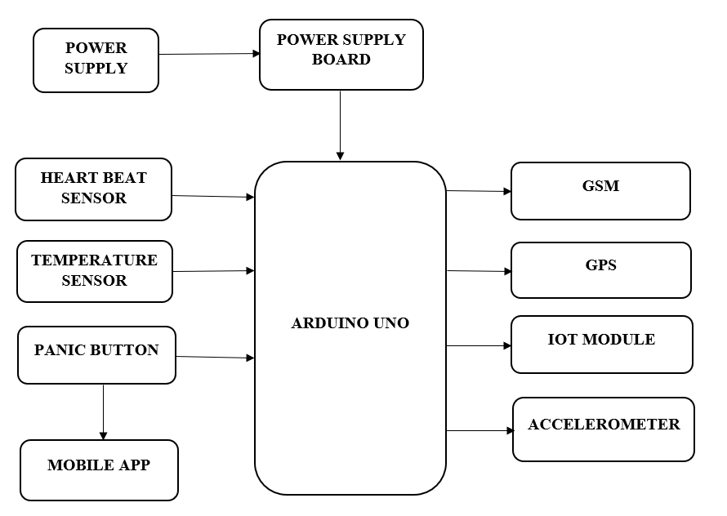
BLOCK DIAGRAM

Slide 5
PROJECT GOALS
To create a reliable and secure device for the protection of children.
To demonstrate the potential productivity, efficiency and associated costs.
Integrate optimized components into an existing design.
Provide plans for the project's successful implementation.

Slide 6
PROJECT APPLICATION
User – friendly interface
Helps in Emergency situations
Security and Safety
SMS communication

Slide 7
REQUIREMENT SPECIFICATION
HARDWARE REQUIREMENT:
1) Arduino UNO
2) Heart beat sensor
3) Temperature sensor
4) Panic button
5) GSM
6) GPS
7) IoT module
8) Accelerometer
9) Power supply
10) Power supply board
SOFTWARE REQUIREMENT:
1) Arduino IDE
2) Blynk Application

Slide 8
REFERENCES
Gordon chu, Noah Apthrorpe , and Nik Feamster,” Security and privacy analyses of internet of things children’s toys ,”in IEEE , October 2018,vol no:5 ,issue no:5,PP:23
Ahlam Shakeel Ansari, Rizwan Siddique, Rasheda Hamdulay, Rasheda Quarishi, Sayed Samiya,” Real Time child Abuse and Reporting Method”, International conference on Advances in Electrical, Electronics, Information, communication and bio informatics, 2018
Mahajabeen Budebhai,” IOT based child and women protection,” International Journal of computer science and mobile Computing, vol no:7, August 2018, issue no:8, page no:141-146
R.Haripriya, S.Hemashree, S,Indrani, S.Kamala Jothi,” child protection wearable gadget” in IEEE Explorer, vol no:118,issueno:20,page no:313
Edyta Rola and Daniel Wdowiez,” It is safer to transport a three year old child in a forward, IEEE,2018

Slide 9
THANK YOU

